Slide 1
DATABASE MANAGEMENT SYSTEM PROJECT
Residential Society Resident &
Maintenance Billing System
Design and Implementation of a Relational Database for Society Residents, Flats, Maintenance Bills, and Payments

Slide 2
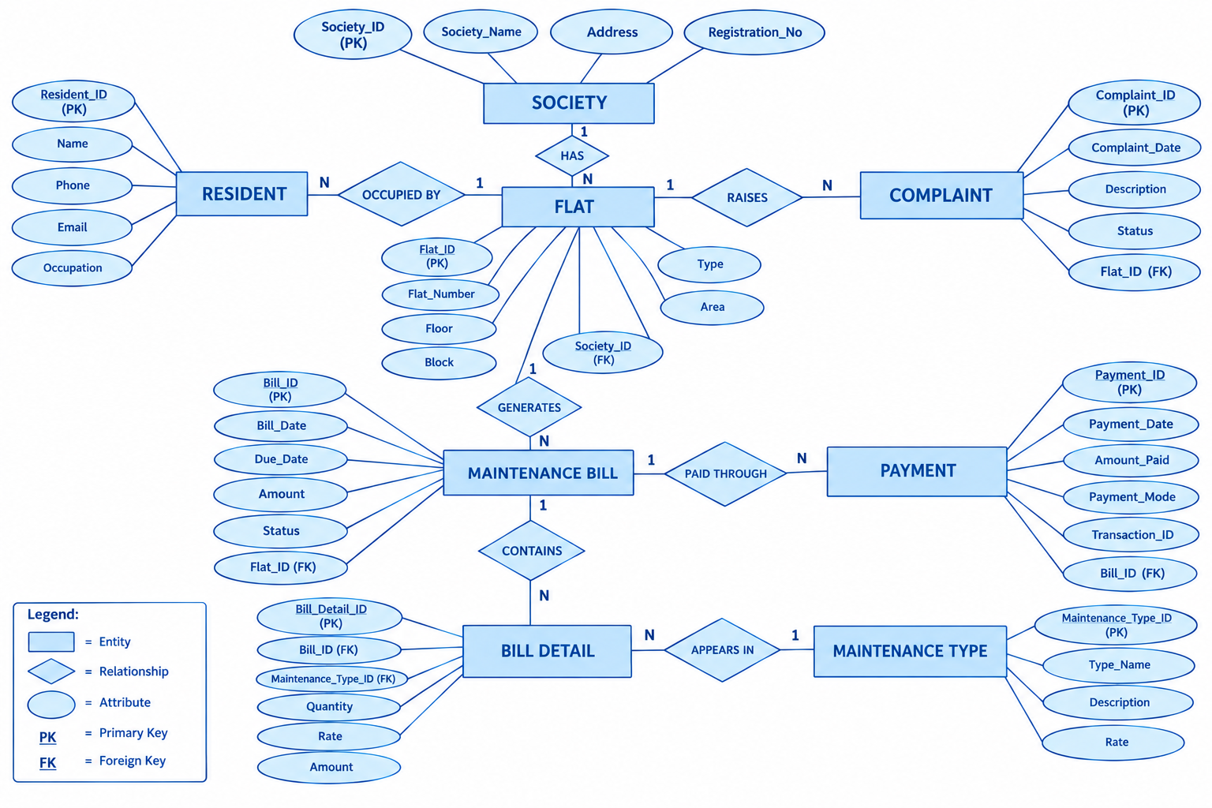

Slide 3
